Slide 1

Psychoinformatics
Hayden N. Walters

Slide 2

What is Psychoinformatics?
Psychoinformatics is an emerging research discipline
A model for measuring randomized behaviour

Slide 3
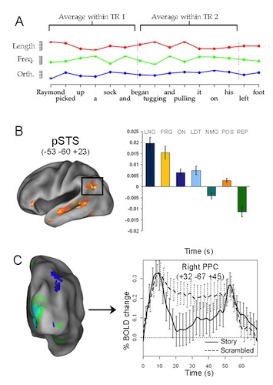
What is Psychoinformatics?
Essentially psychoanalyzing data sets that represent human actions
Few schools
offer it as a single course

Slide 4

What Courses You Should Take?
At the very least a minor in Computer Science (a bachelors degree is preferred)
A Master of Science (M.S.) in Psychology
A Bachelor of Science degree (B.S.) might also be accepted as this is an emerging field
So lots of studying

Slide 5

Where to Take These Courses
The University of Texas at Austin actually has a Psychoinformatics Lab
This course is part of the Department of Psychology, with courses in the Computer Science department

Slide 6

Basic Skills Expected
The ability to write (and read) code in Python
Able to evaluate psychological research and come to a logical conclusion

Slide 7
Basic Skills Expected
Understanding of Big Data and machine learning applications in psychology
Knowledgeable in exploratory
data visualization

Slide 8
Job Outlook
As this is a fledgling field of study an exact estimate is hard to achieve
But, “combining the skill sets of a Psychologist and Data Structure Software Developer would certainly give one an advantage in the job market” – Simon Redmayne

Slide 9
Job Outlook
In the upcoming decades the outlook is promising, as the field expands and is taught as an actual course
Entering this field now could allow you to be on the forefront of something amazing

Slide 10

Where to Work?
Out of the top five cities to work in psychology four are in California
And we all know how computer jobs do out in The Golden State

Slide 11
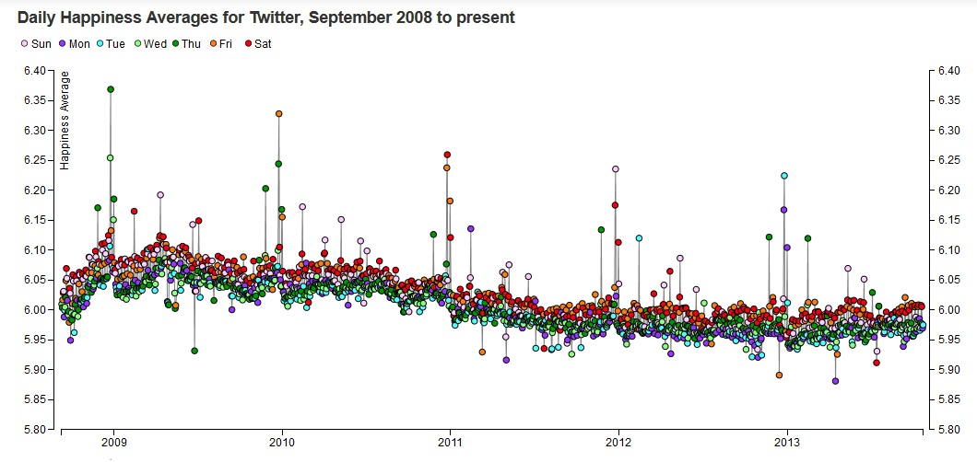
Potential Work Places
Almost anywhere conducting psychological research
A multitude of corporations, schools, and government agencies to improve the acquisition, organization, and synthesis of psychological
data

Slide 12

Annual Average Salary
Hanford, CA- $109,900*
San Luis Obispo, CA- $105,780*
United Kingdom- £58,217 ~ $81,666
(on average)
*Earnings based on normal psychologist salary (actual expected salary would be higher)

Slide 13

Cost of Living
Hanford, CA (Apartment Rent)- $934.00
San Luis Obispo, CA (Apartment Rent)- $1,275.00
United Kingdom (Flat Rent)- £350 -£500 ~ $ 420 -$ 700

Slide 14

Works Cited
https://www.valuepenguin.com/2015/12/best-cities-psychologists
http://journals.sagepub.com/doi/abs/10.1177/0963721412457362
https://www.ncbi.nlm.nih.gov/pubmed/27403204
https://www.meetup.com/action_design_ATX/messages/67108112/?_cookie-check=tW-MSjFjYsPSYbRp
http://pilab.psy.utexas.edu/
https://twitter.com/siliconhbo
https://www.poundsterlinglive.com/usd/2087-investment-and-dollar-sterling-454354

